Slide 1


Ilorin </> DevBox
Building APIs & Microservices (Advanced Hands-On Workshop)
Tuesday Sept 30 2025
Facilitator: Temi Kolawole, Managing Director

Slide 2


Ilorin </> DevBox: Building APIs & Microservices (Advanced Hands-On Workshop)
Outline
Objectives & Recap – Quick look back at Part 1 and today’s learning goals.
Advanced API Design – How to structure endpoints, handle errors, and version APIs.
Security & Authentication – Explore JWT with ReqRes demo and OAuth 2.0 basics.
Documentation & Testing – Using Swagger/OpenAPI, Postman, and Hoppscotch effectively.
Microservices in Action – Real-world examples and how services communicate.
APIs + AI – Using the OpenAI API as a powerful real-world service.
Capstone Project (Lovable.dev) – Build a Task Manager microservice with CRUD operations.
Best Practices & Wrap-Up – Security, scalability, and next steps for your journey.

Slide 3
Ilorin </> DevBox: Building APIs & Microservices (Advanced Hands-On Workshop)
Objectives
Deep dive into advanced API & microservice design.
Learn authentication, authorization, and security patterns.
Get hands-on with documentation and testing.
Understand microservices and real-world integrations.
Build a working API in Lovable.dev.

Slide 4


Ilorin </> DevBox: Building APIs & Microservices (Advanced Hands-On Workshop)
Recap of Part 1
APIs in Everyday Apps – How apps connect for banking, rides, social, etc.
JSON Basics – Reading requests, responses, and payloads.
Monolith vs Microservices – One big kitchen vs food court analogy.
Public APIs with Hoppscotch – Live demo from any phone browser.
African Countries Explorer – Built a working app consuming APIs.

Slide 5

Ilorin </> DevBox: Building APIs & Microservices (Advanced Hands-On Workshop)
Advanced API Design
REST Principles – Organize resources with clear URIs and HTTP verbs (GET, POST, PUT, DELETE).
Endpoint Design – Keep names simple, predictable, and plural (e.g., /tasks, /users/123).
Error Handling – Return meaningful status codes (200 OK, 400 Bad Request, 404 Not Found, 500 Server Error).
API Versioning – Use /v1/ or headers to support updates without breaking clients.

Slide 6

Ilorin </> DevBox: Building APIs & Microservices (Advanced Hands-On Workshop)
Security & Authentication
Why Security? – Protect data, prevent misuse, and ensure trust.
AuthN vs AuthZ – Authentication = who you are; Authorization = what you can do.
Tokens vs Sessions – Tokens travel with each request; sessions stored on server.
JWT Flow – Login → get token → include in Authorization: Bearer <token> header.
OAuth 2.0 Basics – Delegated login with Google, Facebook, GitHub, etc.

Slide 7
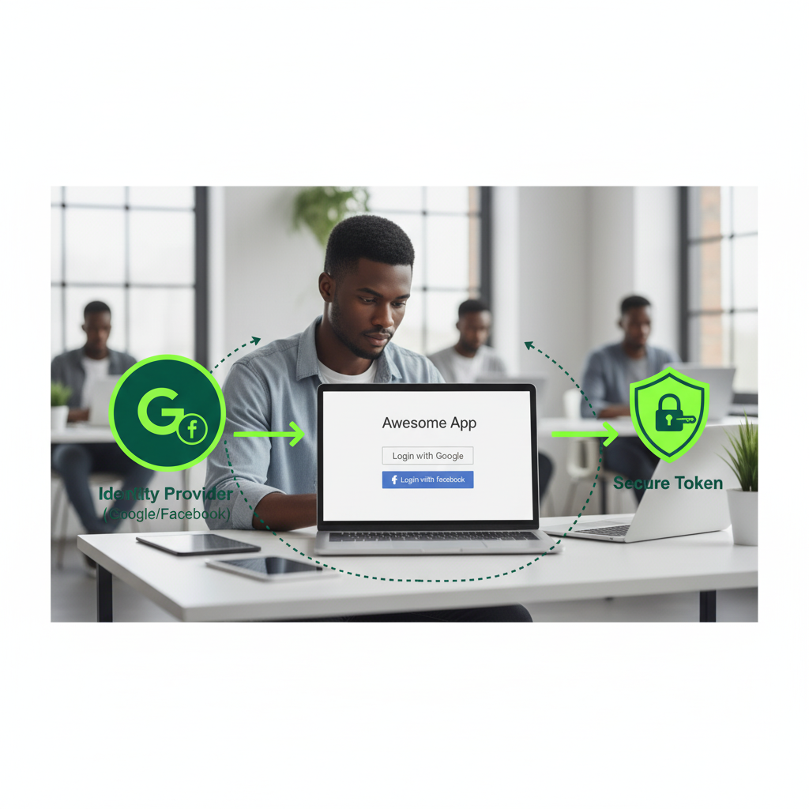
Ilorin </> DevBox: Building APIs & Microservices (Advanced Hands-On Workshop)
OAuth Basics
What is OAuth?
An authorization framework for secure delegated access.
Lets apps access user data on another service without sharing passwords.
How it works (simplified)
User clicks “Login with …” (Google, Facebook, etc.)
Redirect to provider → user approves access.
Provider sends back an access token.
App uses the token to access APIs on behalf of the user.
Key Benefits
More secure than passwords.
Widely used across the web (social logins, payments, APIs).
Standardized and scalable.

Slide 8
Ilorin </> DevBox: Building APIs & Microservices (Advanced Hands-On Workshop)
JWT (JSON Web Token)
How it works
User logs in → server issues JWT.
Client stores token (usually in memory).
Every request → send Authorization: Bearer <token>.
Server verifies signature before granting access.
Why JWT?
Stateless (no need to store sessions on server).
Widely used in modern APIs.
What is JWT?
A compact, secure way to transmit information between client and server.
Used for authentication and authorization.
Structure (3 parts)
Header → algorithm & token type.
Payload → user data / claims.
Signature → verifies authenticity.

Slide 9

Ilorin </> DevBox: Building APIs & Microservices (Advanced Hands-On Workshop)
Documentation & Testing Tools
Swagger / OpenAPI Auto-generate interactive docs, test endpoints, and share with teams.
Hoppscotch (alternative to Postman) Lightweight web app for testing APIs — no install, works on any device, supports GET, POST, PUT, DELETE.
Why It Matters Documentation + testing keep APIs consistent, easy to use, and prevent confusion across developers and teams.

Slide 10
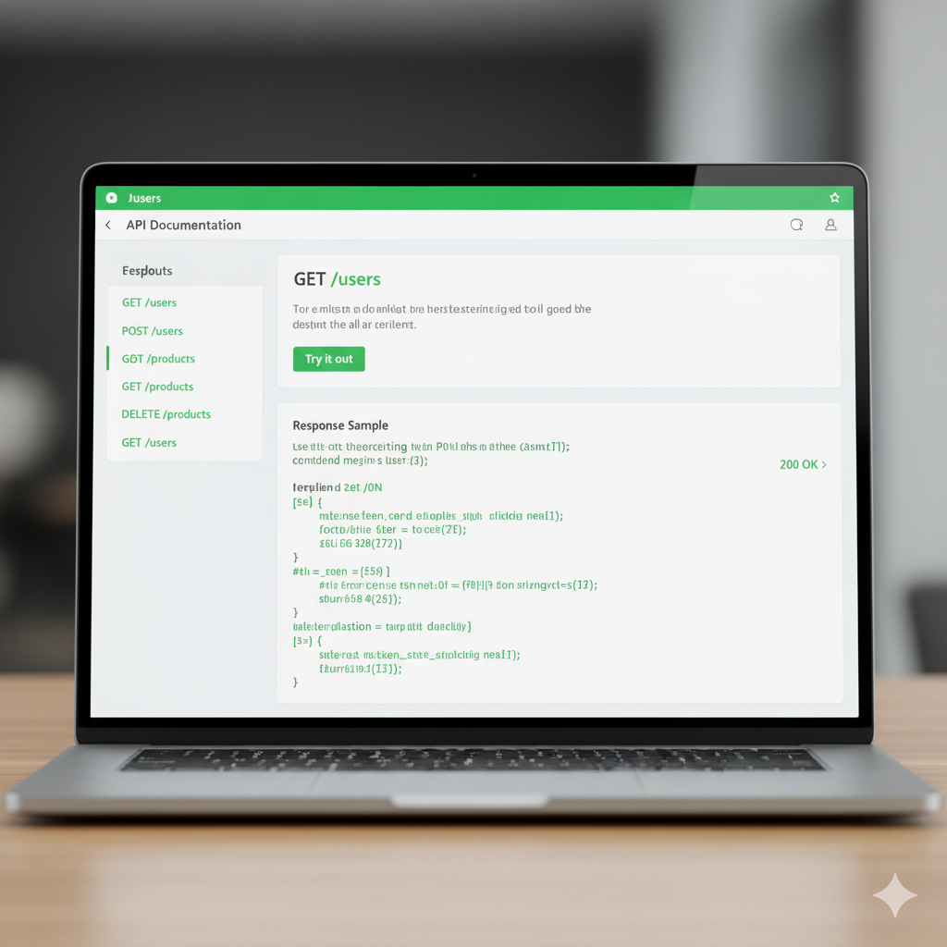
Ilorin </> DevBox: Building APIs & Microservices (Advanced Hands-On Workshop)
Swagger/OpenAPI
What is Swagger?
A framework for describing APIs in a standardized way.
Uses OpenAPI Specification (OAS) to define endpoints, requests, and responses.
Why it matters
Generates interactive documentation automatically.
Lets developers test APIs in the browser (try it out).
Helps keep docs and implementation in sync.
Example
/docs endpoint in many APIs opens Swagger UI.
Clear sections: endpoints, parameters, responses, errors.
Key takeaway Swagger makes APIs self-explanatory, testable, and shareable.

Slide 11
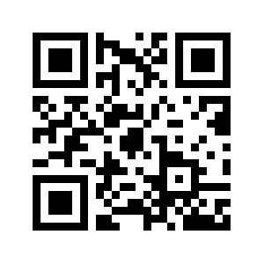
Ilorin </> DevBox: Building APIs & Microservices (Advanced Hands-On Workshop)
Hands-On: JWT with ReqRes
Purpose: Fake API for testing authentication flows.
Login Endpoint: POST https://reqres.in/api/login Body:
{ "email": "eve.holt@reqres.in", "password": "cityslicka" }
Response:
{ "token": "QpwL5tke4Pnpja7X4" }
You can then pass that token in Authorization: Bearer headers to access protected resources (simulated).

Slide 12
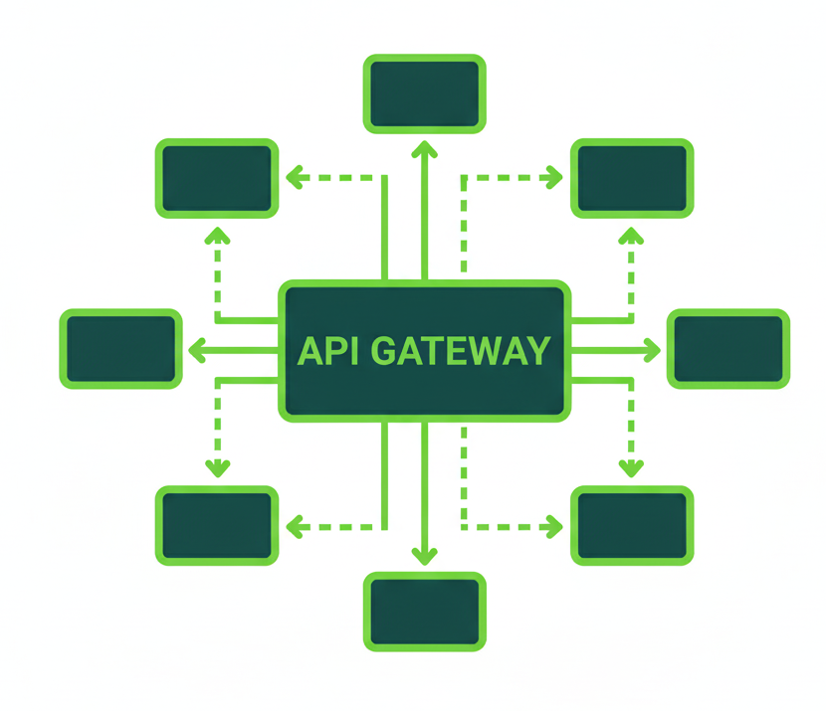
Ilorin </> DevBox: Building APIs & Microservices (Advanced Hands-On Workshop)
Microservices in Action
Real-World Use Cases Payments (Paystack, Flutterwave), messaging (WhatsApp), authentication (Google login).
Service-to-Service Communication REST APIs (common, human-readable) vs gRPC (faster, binary, optimized for service-to-service).
Scaling & Deployment Independent services scale individually; use Docker and cloud orchestration (Kubernetes) for deployment.
Visualize It Imagine a diagram: multiple small services (Auth, Payments, Orders, Notifications) communicating through APIs instead of one large system.

Slide 13
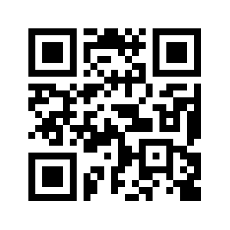
Ilorin </> DevBox: Building APIs & Microservices (Advanced Hands-On Workshop)
APIs + AI (OpenAI Example)
How It Works OpenAI API = text in → JSON out.
Example Request: prompt in natural language. Response: structured JSON with AI-generated text.
Use Case Add intelligence to microservices (chatbots, summarization, content generation).
Resources Explore docs & playground: platform.openai.com.

Slide 14
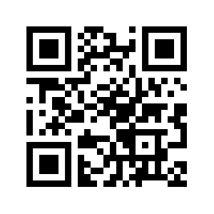
Ilorin </> DevBox: Building APIs & Microservices (Advanced Hands-On Workshop)
Capstone 1 – Build an API
Paste the exact API prompt (the one in QR) into Lovable.
Generate the Nigeria Civic Geo API.
Show the Swagger docs at /docs.
Demo endpoints in Hoppscotch (using JWT auth flow):
POST /auth/login → get token.
GET /states (with Bearer token).
GET /lgas?state=Kwara.
GET /wards?state=Kwara&lga=Ilorin East.
GET /search?q=Ilorin.
Learning Outcome: Students see how JSON → becomes → API → becomes → usable service.

Slide 15
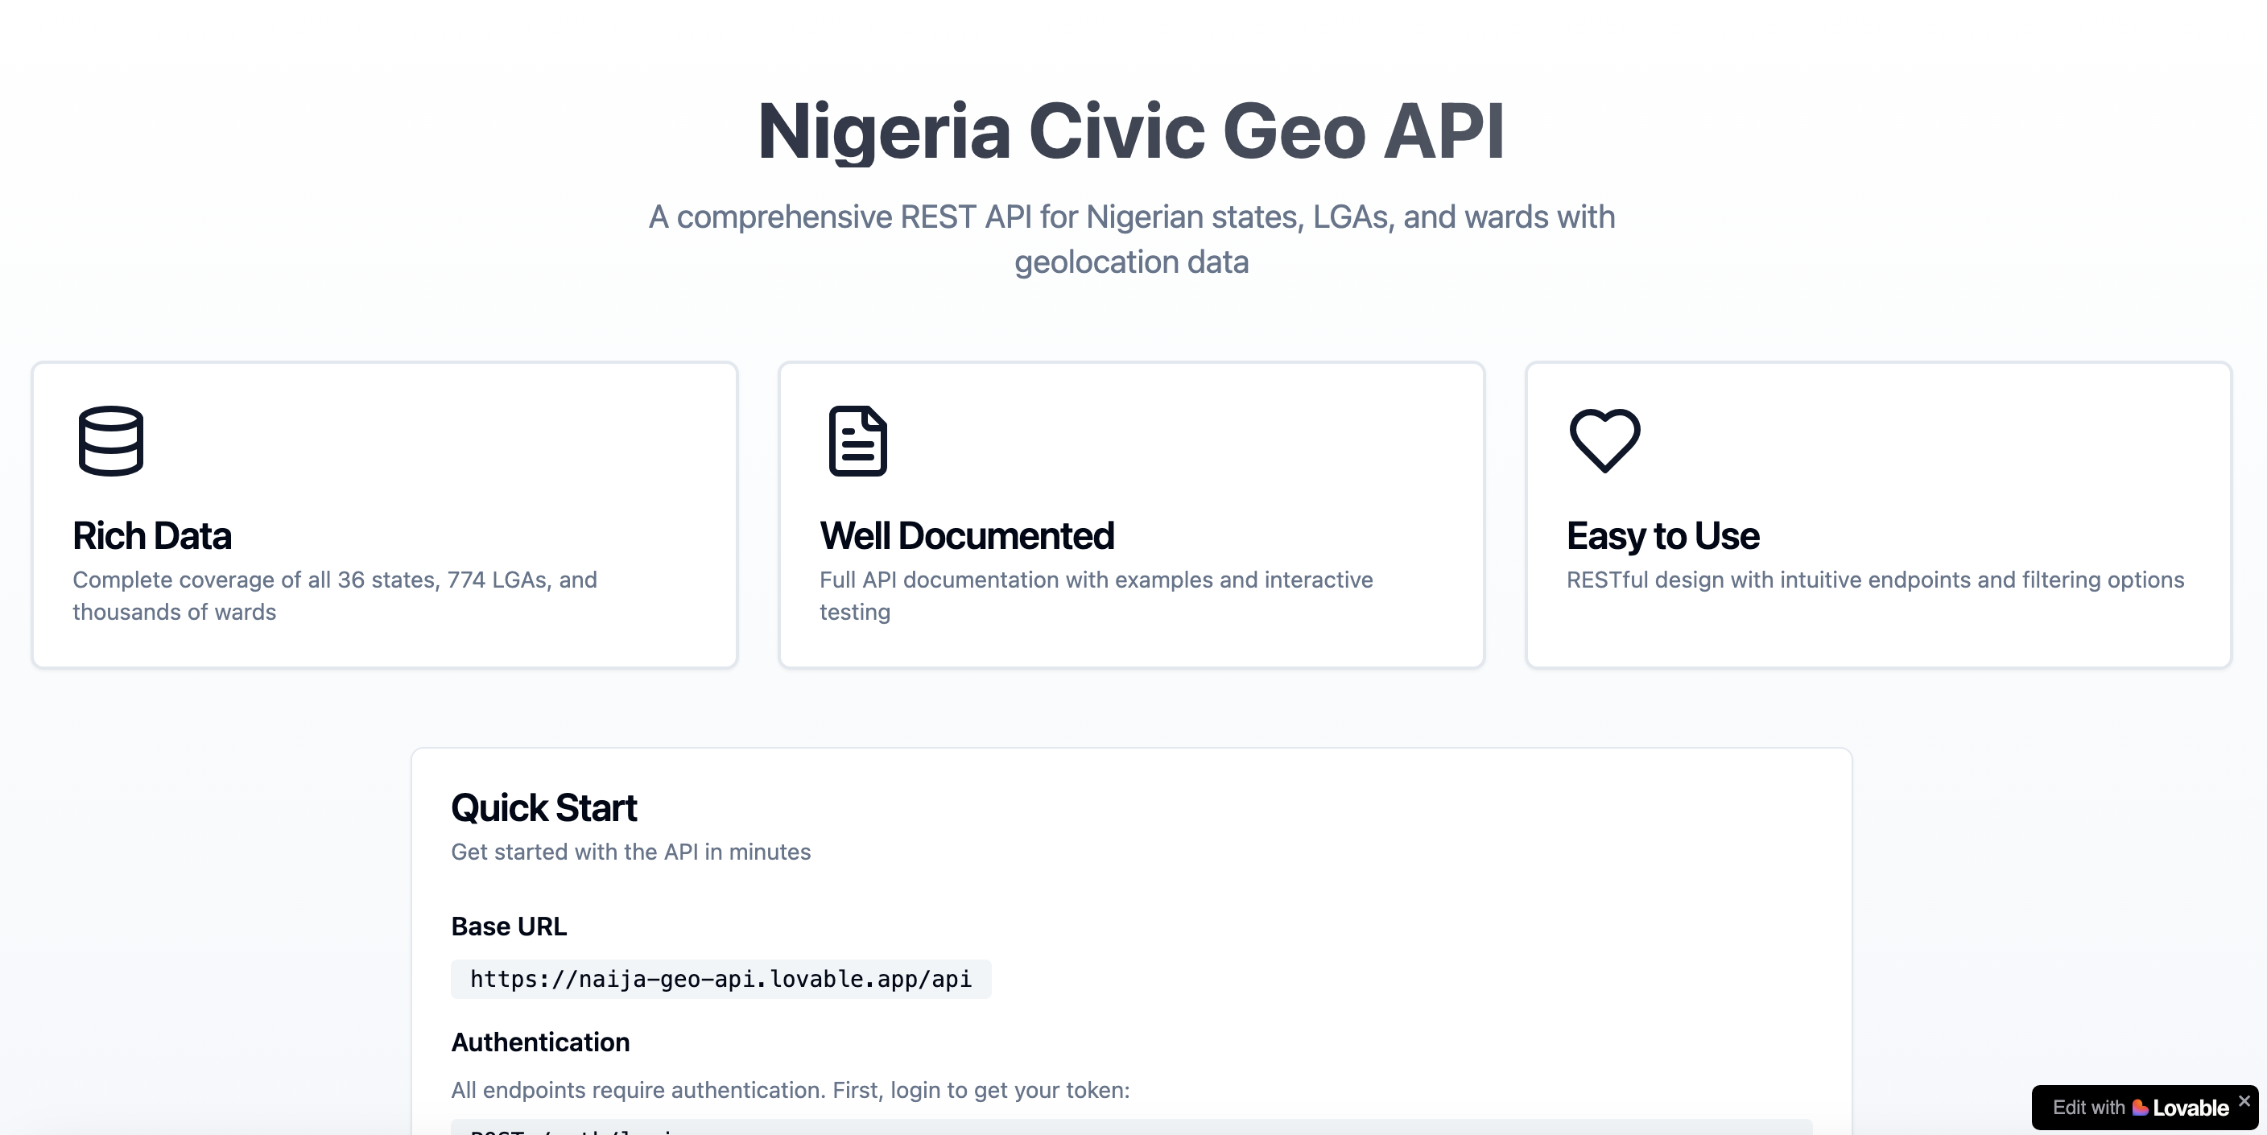
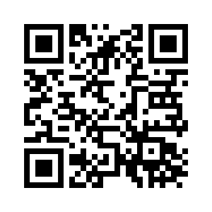
Ilorin </> DevBox: Building APIs & Microservices (Advanced Hands-On Workshop)
Capstone 1 – Build an API
https://naija-geo-api.lovable.app/

Slide 16
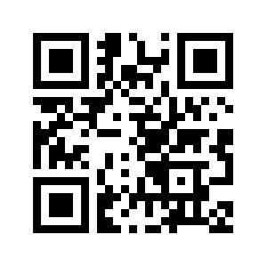
Ilorin </> DevBox: Building APIs & Microservices (Advanced Hands-On Workshop)
Capstone Part 2 – Build the Civic App
Paste the exact API prompt (the one in QR) into Lovable.
Build a mobile-friendly app called Nigeria Civic Explorer that consumes the API built.
Core Features:
Login Screen → enter email/password, call /auth/login.
Search Bar → calls /search?q= and displays grouped results (state, LGA, ward).
Browse Filters → dropdowns for State → LGA → Ward.
Ward Details Page → show ward name, parent LGA and State. If geometry exists, map it with Leaflet.
Error Handling → show alerts for 401 (unauthorized) and 404 (not found).
Add a footer: “Built during Ilorin DevBox Part 2 at Ilorin Innovation Hub.”
Learning Outcome: Students experience how an API powers a real-world civic app for elections and governance.

Slide 17

Ilorin </> DevBox: Building APIs & Microservices (Advanced Hands-On Workshop)
Best Practices
Secure Your APIs – Protect endpoints with authentication, authorization, and rate limits.
Always Document – Use Swagger/OpenAPI to keep APIs clear and consistent.
Respect Limits & Ethics – Avoid abuse, handle data responsibly, and respect user privacy.
Plan for Scalability & Versioning – Design APIs that can grow and evolve without breaking existing apps.

Slide 18

Ilorin </> DevBox: Building APIs & Microservices (Advanced Hands-On Workshop)
Wrap Up & Next Steps
Recap
Advanced API design, JWT & OAuth
Documentation & testing
Microservices in action
OpenAI integration
Follow-up
Share sample projects & code templates
Community showcase at next DevBox

Slide 19
Thank you.

